Slide 1
Cloud Enabled Vehicle Theft
Team name : sparks
PROJECT MEMBERS:
Y.Triveni
K.Kaushik
S.Malavika

Slide 2
abstract
Insecurity is one of the major challenges that the entire world is facing now, each country having their peculiar security issues. The crime rate in every part of the society these days has become a threatening issue such that vehicles are now used for committing criminal activities more than before. The issue of vehicle theft has increased tremendously, mostly at gunpoint or car parks. In view of these, there is a need for adequate records of stolen, identified and recovered vehicles which are not readily available in our society and as such very important. The development of a vehicle theft alert and location identification system becomes more necessary for vehicle owners to ensure theft prevention and a speedy identification towards recovery efforts in situations where a vehicle is missing, stolen or driven by an unauthorized person. The theft alert function makes use of a GSM application developed and installed in a mobile phone device which is embedded in the vehicle to communicate with the vehicle owner’s mobile phone. The communication is established via SMS (i.e. between the installed mobile phone device and that of the vehicle owner).

Slide 3
INTRODUCTION
In recent years vehicle theft has become a major issue which should be traced and detected. The safety and security of the vehicle is essential. Even there are many existing mechanisms they have some limitations and high cost. So, an efficient security mechanism is needed.
This project detects vehicle theft. Arduino is the main component which is used to interface dc motor and GPS, switch . The place of the vehicle identified using
Global positioning system (GPS) and Global system mobile communication (GSM) with the help of Wi-Fi module ESP 8266. GPS is a space-based navigation system used to track the vehicle and it gives the location of the robbed device in all weather conditions. It gives the latitude and longitude of the device using GPS antenna.
Vehicle Tracking System becomes very important now days, especially in case of stolen vehicles. If you have GPS system installed in your vehicle, you can track you Vehicle Location, and its helps police to track the Stolen Vehicles. Previously we have built similar project in which Location coordinates of Vehicle are sent on Cell Phone

Slide 4
Block diagram
nodemcu
gps
cloud
Node red
servomotor
Mobile app

Slide 5
Hardware components
NodeMCU
GPS Module
Servomotor

Slide 6
Explanation of hard ware components
* Servo Motor: Most common type of motor. servo motors normally have just two leads, one positive and one negative. If you connect these two leads directly to a battery, the motor will rotate. If you switch the leads, the motor will rotate in the opposite direction.
Switch: This is used to activate the entire theft detection system. As long as switch is in ON position SMS alert and location will be sent to owner as soon as vehicle starts. If the switch is OFF, no alert will be sent and location details are also not shared. In this way, using switch we can control system activation and deactivation.
Gps (Global Positioning System): Global Positioning System (GPS) is a satellite-based navigation system. We use NEO-6M GPS module as it is compatible with a variety of GPS receivers. It has a built-in ceramic antenna. Integrates with a 3V button battery. Normally GPS works in any weather conditions at anywhere in the world. A GPS receiver must be locked on to signal of at least 3 satellites to estimate 2D position (Latitude and longitude).

Slide 7
Software components
Arduino
IBM Cloud
Android Studio

Slide 8
Project Description
Vehicles are to be secured from both on road and off the road where as in case of on road one have to know about the accident(s) and in case of off the road vehicle thefts are to be controlled. When person wants to open the vehicle door he has to press the button. After pressing the button it notifies the owner by sending notification to mobile app and asks for authentication. now the door opens only after authentication. If unauthorized person tries to open the door then you can lock the car by pressing the button in the mobile app. we can track our vehicle in the mobile app by using the gps coordinates.

Slide 9
procedure
This project presents an IOT based vehicle theft detection system. As there are many systems used till date to detect the robbed vehicle, proposed system overcomes most of the limitations of existing systems and methods. In this mechanism as soon as the dc motor starts i.e., vehicle theft occurs, Arduino activates GPS, GSM and sends an alert message to the owner and the longitude and latitude readings of vehicle are posted using internet of things with the help of Wi-Fi module. The entire mechanism can be operated with a switch which is made ‘on’ when we park the vehicles out.
Now if thr vehicles theft happened dc servo motor starts and the above procedure continues and the information is posted during internet of things

Slide 10
Here we are building more advanced version of Vehicle Tracking System in which you can Track your Vehicle on Google Maps. In this project, we will send the location coordinates to the Local Server and you just need to open a ‘webpage’ on your computer or mobile, where you will find a Link to Google Maps with your Vehicles Location Coordinates. When you click on that link, it takes you on Google Maps, showing your vehicles location. In this Vehicle Tracking System using Google Maps, GPS Module is used for getting the Location Coordinates, Wi-Fi module to keep send data to computer or mobile over Wi-Fi and Arduino is used to make GPS and Wi-Fi talk to each other.

Slide 11
The project proposes a GPS based vehicle tracking system that tracks the vehicle and sends the tracking data over through a sms. The microcontroller acts as the controlling head of the system. When the system goes in Theft mode the authorized user gets the alert message and user will Able to stop the vehicle engine immediately by controlling the engine through the mobile app. The system includes a GPS modem that tracks the vehicle location in the form of latitude and longitude. This location can be accessed via sms that is being sent to the user. With the help latitude and longitude information SMS user will able to locate vehicle with Google map. This system proves very beneficial for transport and travel companies as they can now keep track of their vehicles.

Slide 12
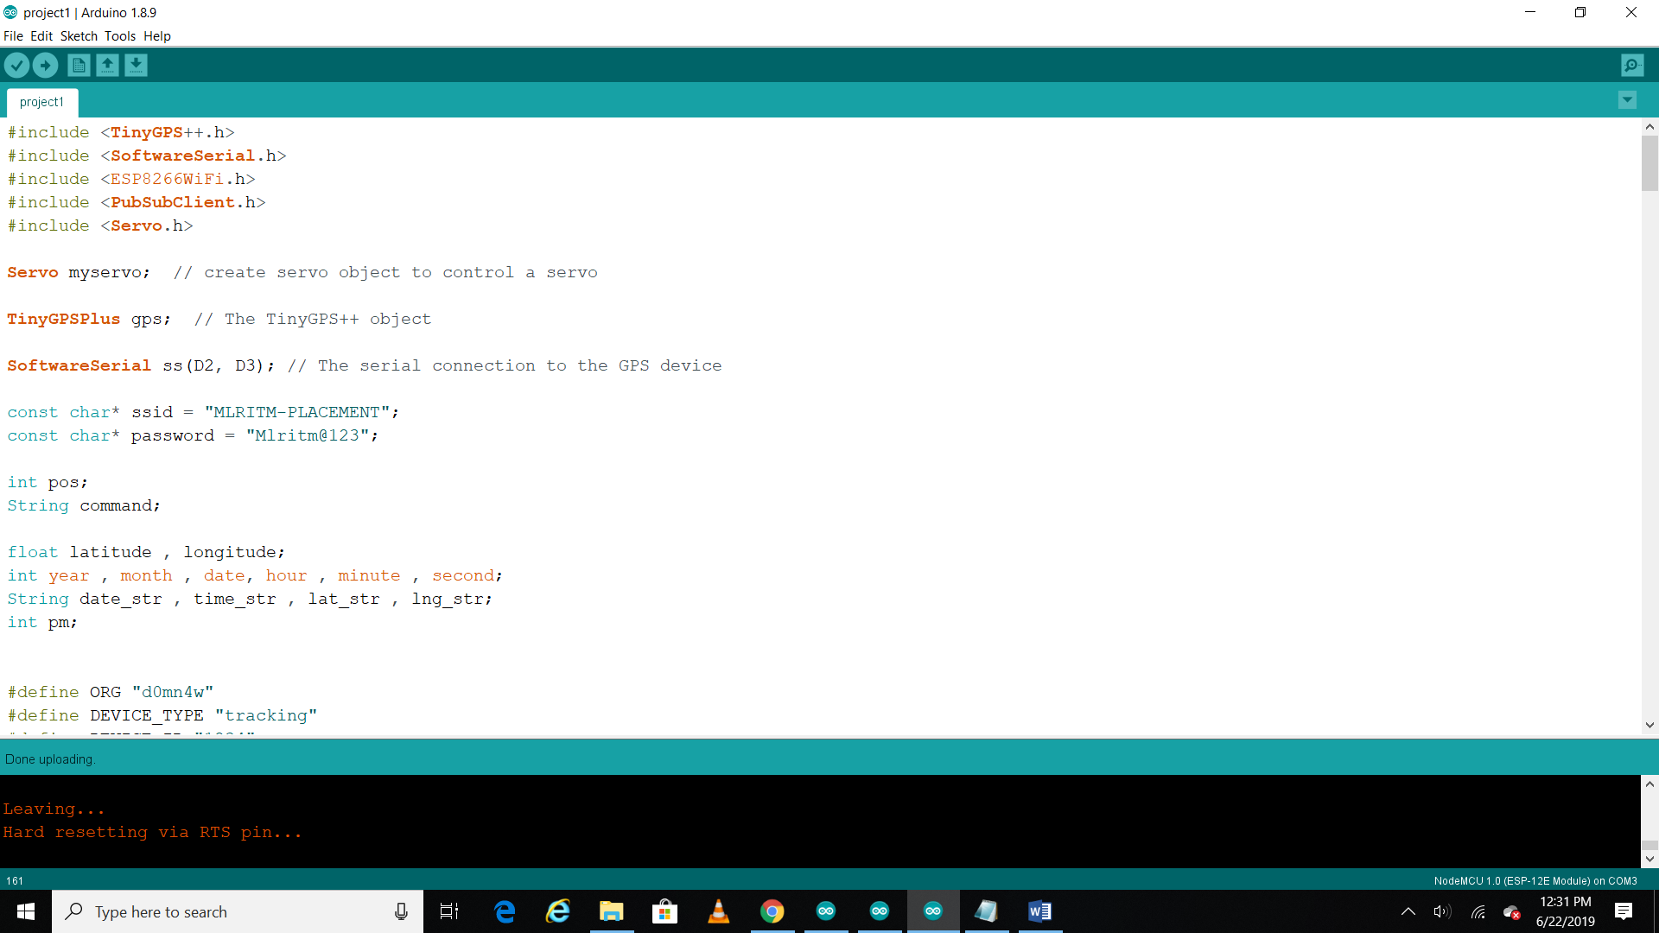
Program on vehicle theft

Slide 13
PROCEDURE FOR MIT APP
Login to your IBM cloud account.
Launch NODE-RED which is IBM
Watson IOT platform.
Create a user interface between
Watson service and the device.
Open MIT app inventor and create a
mobile application for your
respective project.
After dumping the code in the
NODE MCU ,install the app (MIT
application) which helps you in
“tracking the location”

Slide 14
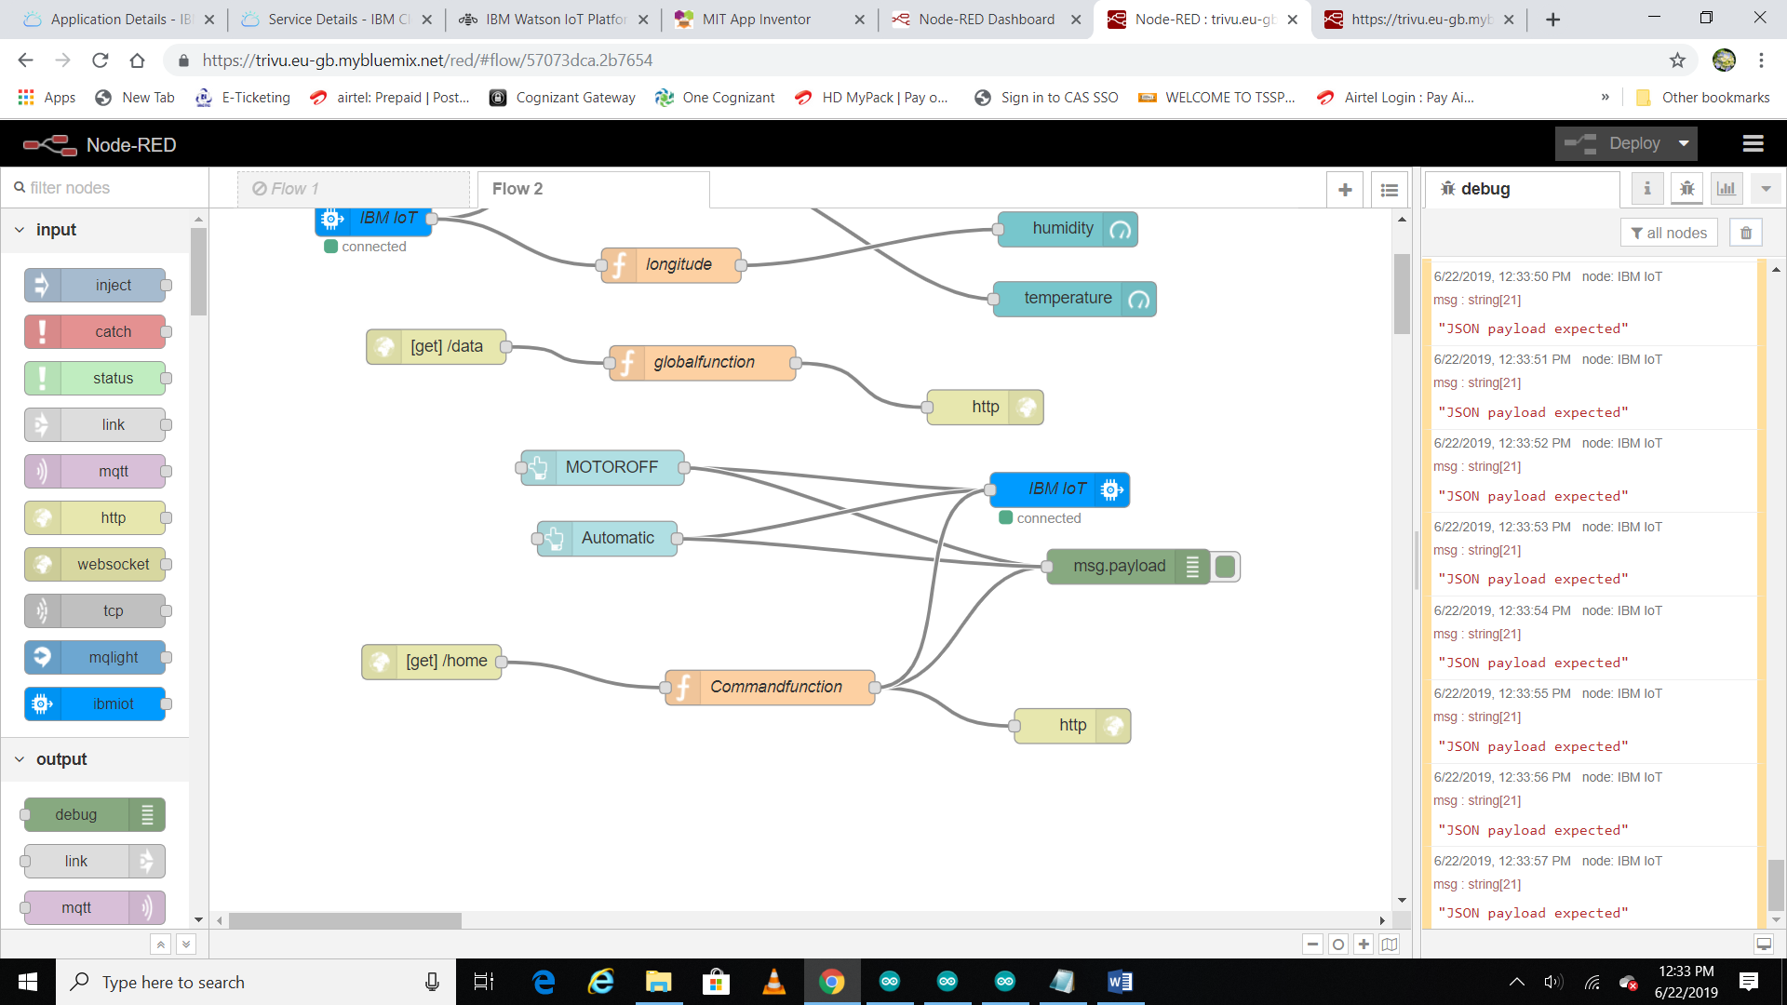
Node RED

Slide 15
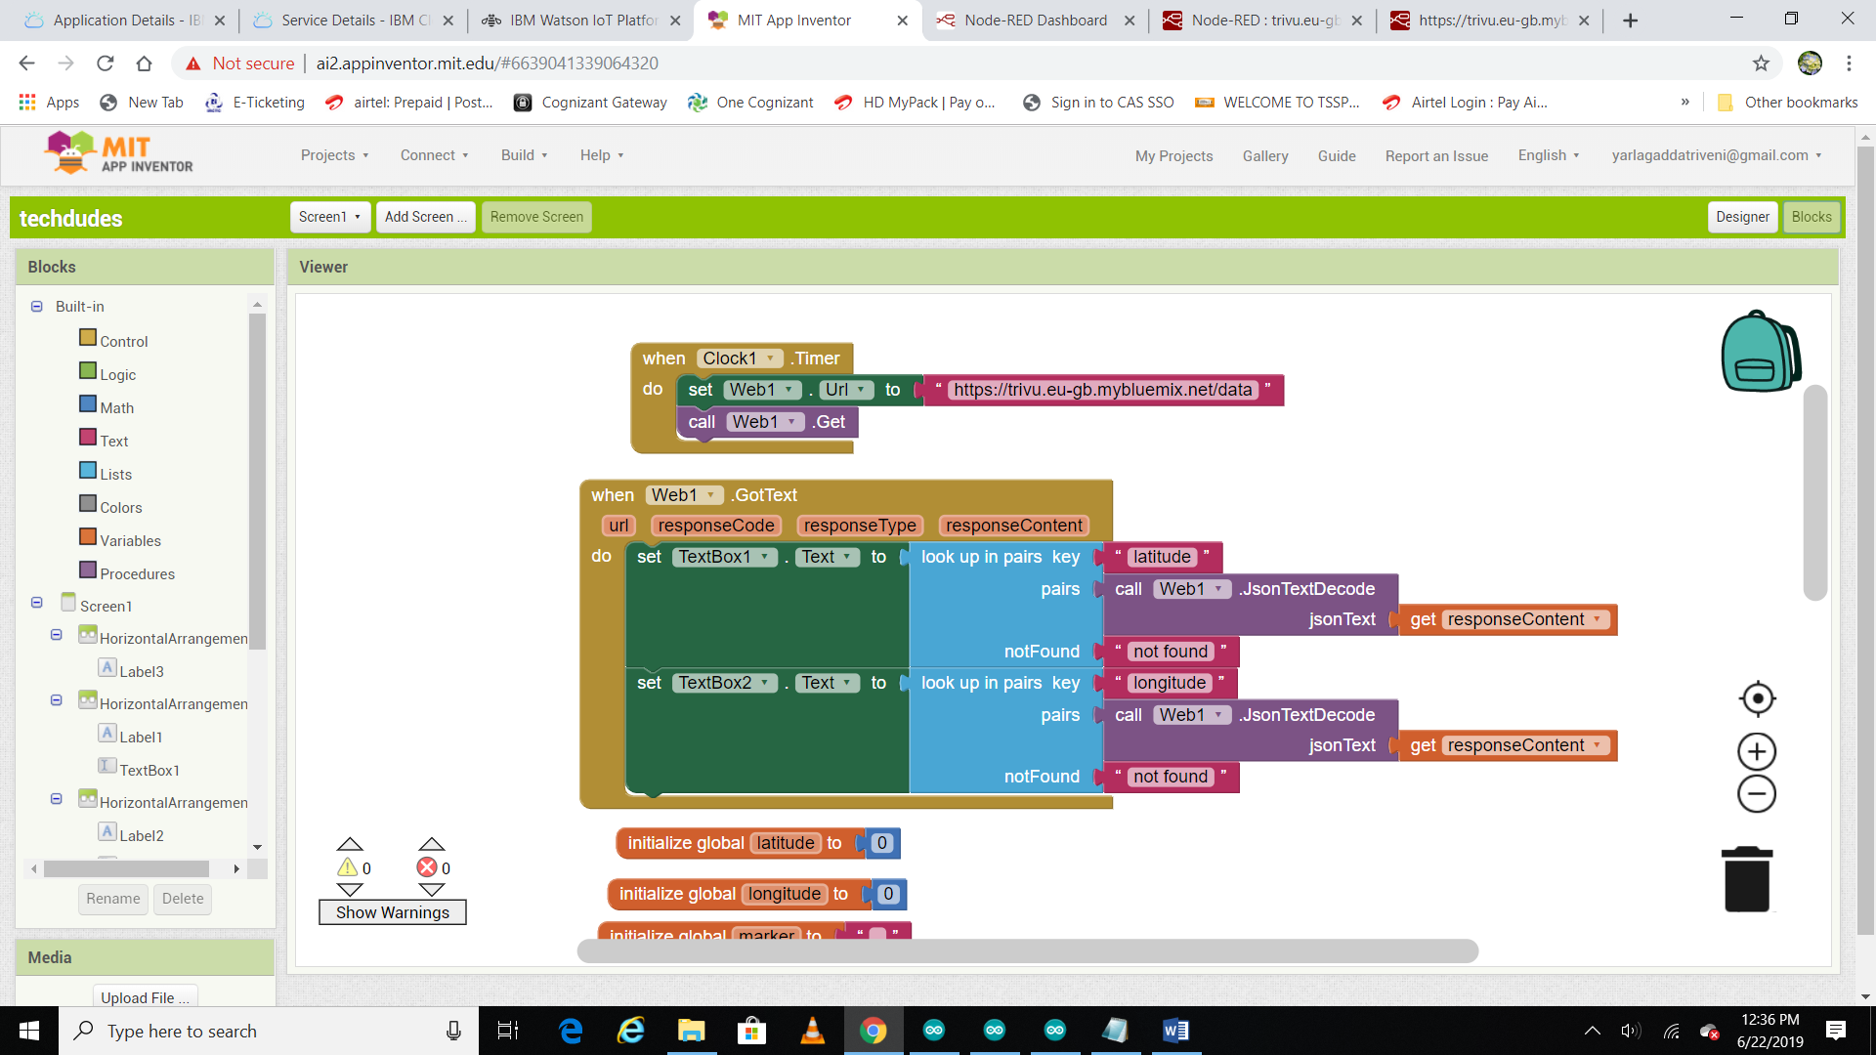
MIT APP

Slide 16
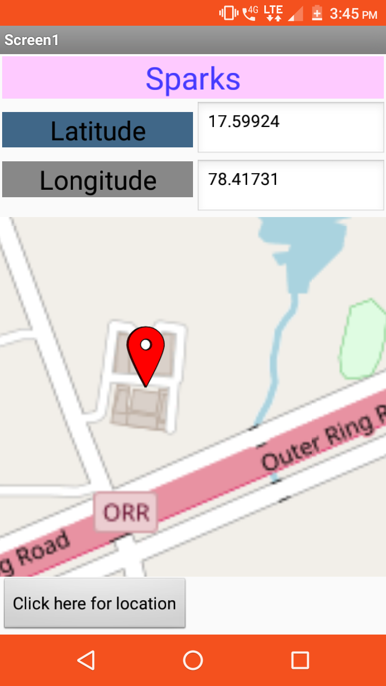
Location tracking

Slide 17
APPLICATIONS AND ADVANTAGES
Applications and Advantages:
There are many Applications of GPS based Vehicle theft detection system using GSM technology, few of them are listed below:
1) GPS Car theft detection can be used in transportation vehicles of Companies, schools, colleges and industries.
2)The developed system is of low cost, reliable and compact. The hardware modules used in the project are easily accessible
3)This project can be deployed in various different fields like elderly and disabled care services, logistic division, emergency services and rescue operation, school bus tracking, and accounting
Advantages:
1) This project is easy to install and easy to use.
2) We get the exact co-ordinates of location. So there is no chance of errors.
Future Development:
1) We can add vehicle engine locking system.

Slide 18
Thank you
By team :25
Name : sparks

